Slide 1

Meeting 1
OpenPifPaf
Guillaume Krafft

Slide 2
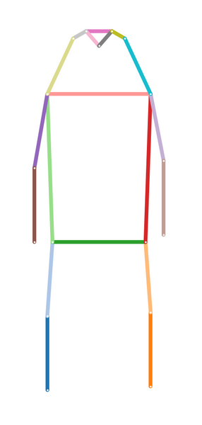
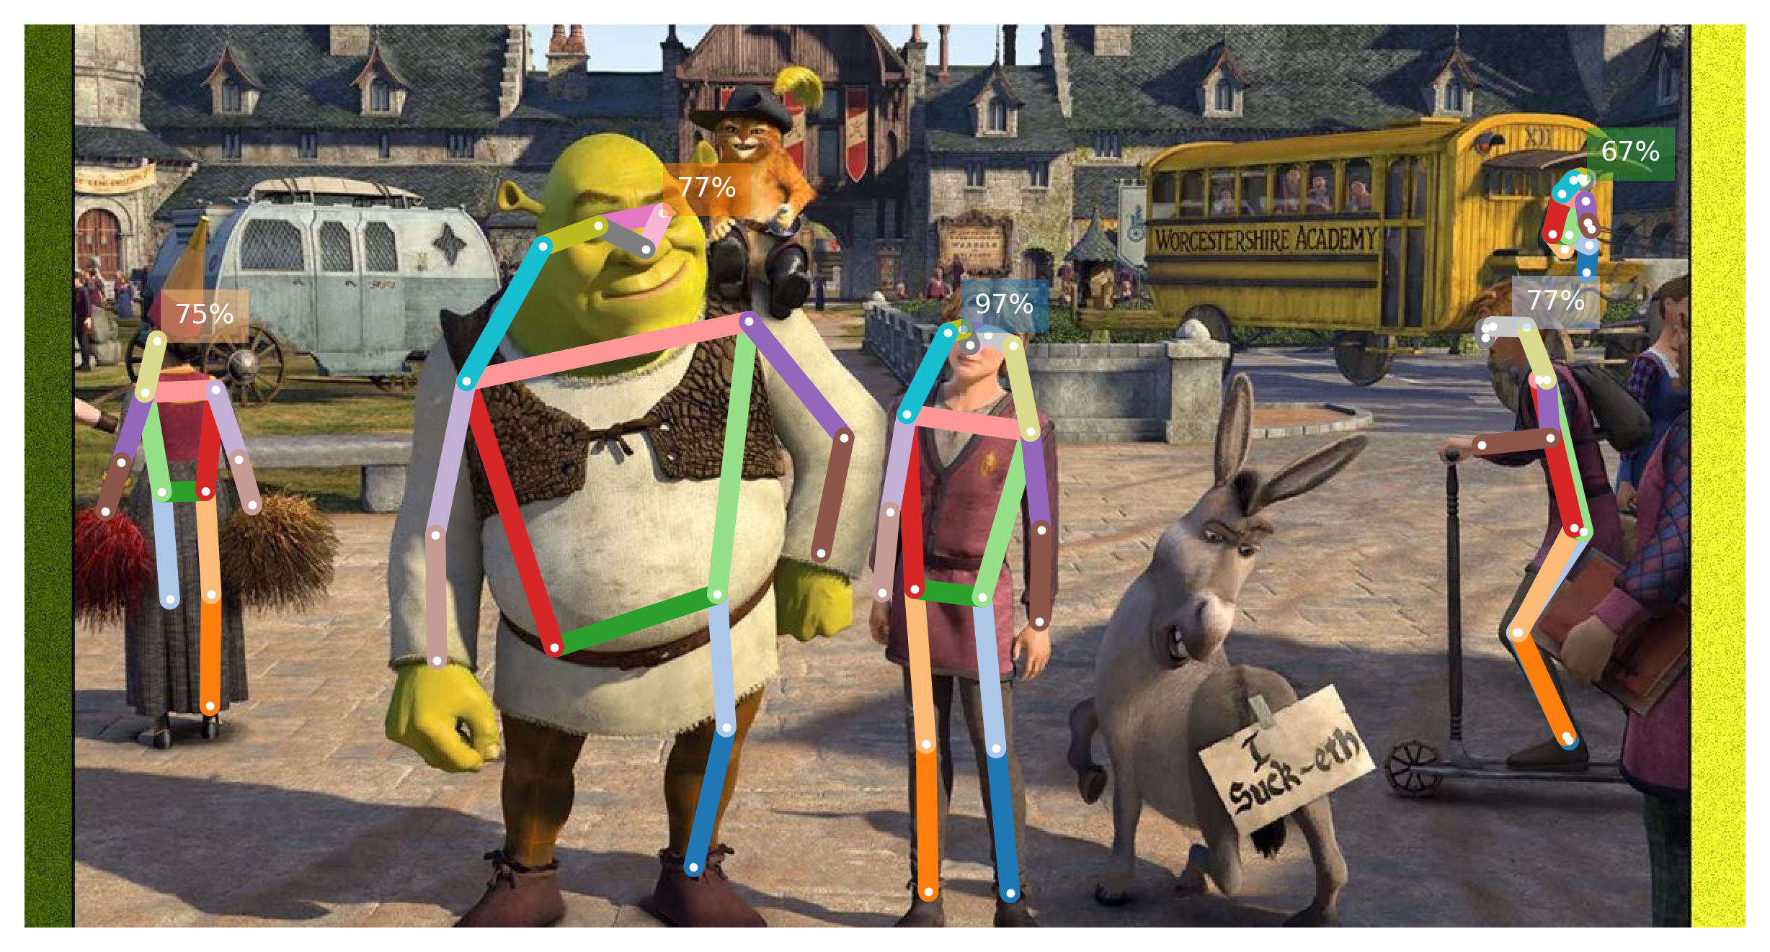
Keypoint tracking: OpenPifPaf
Semantic keypoint detection algorithm developed in Prof. Alahi’s lab
Offers a prediction API
Notes:
Keypoints are mapped following the COCO keypoints format. COCO = Common Objects in Context, huge dataset regroups a lot of data for different tasks such as object detection, image captioning and keypoint detection. https://cocodataset.org/#keypoints-2020.

Slide 3
Demo on notebook

Slide 4
Future work
Redo the same pose detection algorithm using another library to explore other and maybe more efficient pose detection algorithms
Detect if the subject looks at the camera
Look further in the documentation about fusing video and audio
Setup a simple demo using the exisiting robot commands (?)

